Slide 1
INTEGRATED MICRO-PLANNING FOR ROUTINE IMMUNIZATION

Slide 2
THE FIVE RED/ REC STRATEGY COMPONENTS
Ensure the 5 components are included:
Re-establishing of outreach services
  regular outreach for communities with poor access
Supportive supervision
  on site training by supervisors
Linking services with communities
  regular meetings between community and health staff
Monitoring and use of data for actions
  chart doses, map population in each health facility
Planning and management of resources
  better management of human and financial resources

Slide 3
EXAMPLE: DISTRICT MANAGEMENT OF RESOURCES
With limited
resources:
With extra
resources:
e.g.:
better supplies forecasting
regular feedback to staff; more supervision
convenient
schedule for
sessions
e.g.:
additional supplies & equipment
more staff & refreshing training
more vehicles for outreach sessions
SUPPLY
STAFFING
SERVICE DELIVERY
RED Strategy – District microplanning

Slide 4
OBJECTIVES OF MICRO-PLANNING
In a defined catchment area of a health centre or Union Council,
Determine the resources necessary to achieve a given vaccination coverage rate
Determine the strategies necessary to achieve a given vaccination coverage rate
Develop a plan of vaccination activities to be implemented in the year
RED Strategy – District microplanning

Slide 5
KEY POINTS FOR RI MICRO-PLANNING
New Born Tracking…Must try to have as accurate count of children < 1 year as possible
Outreach…typically 50-70% or more of routine immunization coverage will be achieved through outreach
Community informed……This is not a house-to-house activity therefore people need to know the schedule and venue of the outreach vaccination activities

Slide 6
Development of RI Micro-plan of an Union Council
STEPS IN THE PROCESS
Step 1: Draw a UC map showing
  Health facilities/functioning EPI centers
  Community/villages with their monthly target for <1 yr children
  Distance to the community/villages from the health center with common mode of transport
  Major geographical landmarks e.g. river, canal, roads etc.
Existing Polio SIA micro-plan map can be used for this purpose

Slide 7
Development of RI Micro-plan of an Union Council
STEPS IN THE PROCESS
Step 2: Identify the catchment area of the existing EPI fixed center(s) on the map
  This can be done by demarcating an area 3 km radius or 30 min travel distance around the fixed center(s)
Step 3: Dividing the rest of the area of the UC (excluding the fixed center catchment area identified in step 2) in to 16 – 18 blocks
  Boundary of village/community, major landmark (e.g. river, canal, roads etc.), target children are to be considered for identifying these blocks
  Each block is to be assigned for an outreach /mobile vaccination activity for one day
  Identify location of outreach vaccination sites in the blocks

Slide 8
Development of RI Micro-plan of an Union Council
STEPS IN THE PROCESS.....cont.
Step 4: Assigning specific date for every outreach/mobile vaccination session in every block
  Name of the staff responsible for conducting a vaccination session in a particular block on a particular date also to be specified in the micro-plan
  Depending on number of immunization staff available in the UC, more than one outreach vaccination session can be planned on any given day
  If there is no SIA scheduled in any particular month, then the required number of days dedicated to routine outreach can be increased in that month
  If there are one or more SIAs in a month then a lesser number of outreach sessions to be planned in that month
  Attempts are to be made so outreach sessions are conducted in areas having maximum number of target children in such months
Step 5: Develop vaccine and logistics distribution, transportation and supervision plan for each outreach vaccination session and mobile activity

Slide 9
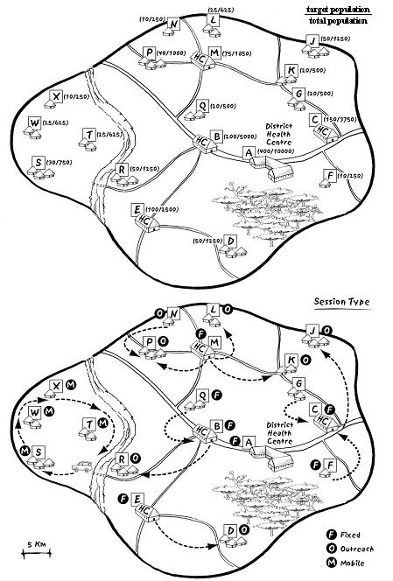
Making an UC map
Decide delivery strategy for every village/community:
Fixed
Outreach
Mobile team

Slide 10
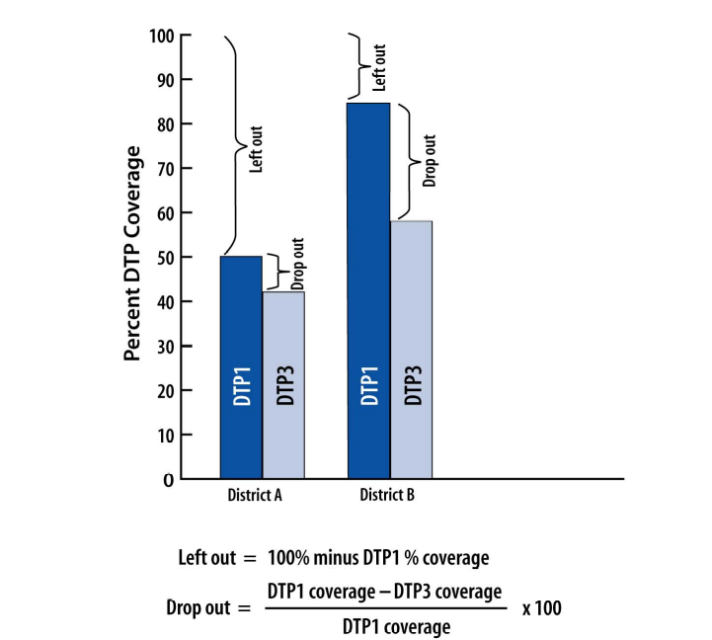
THE PROBLEM: NEVER-REACHED OR DROP-OUTS?

Slide 11
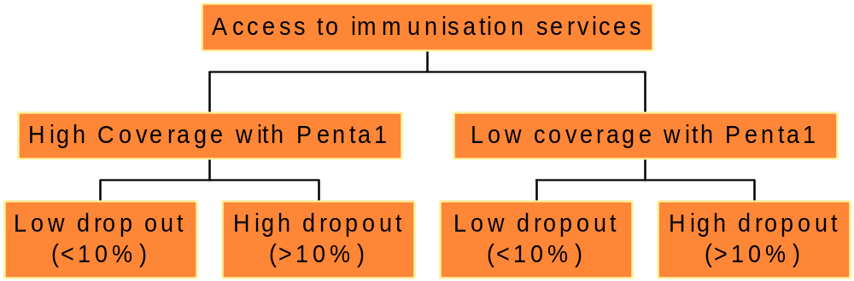
ASSESSING THE PROBLEM
Interpretation
Category 1
Good access
Good utilizat.
Category 2
Good access
Poor utilizat.
Category 3
Poor access
Good utilizat.
Category 4
Poor access
Poor utilizat.

Slide 12
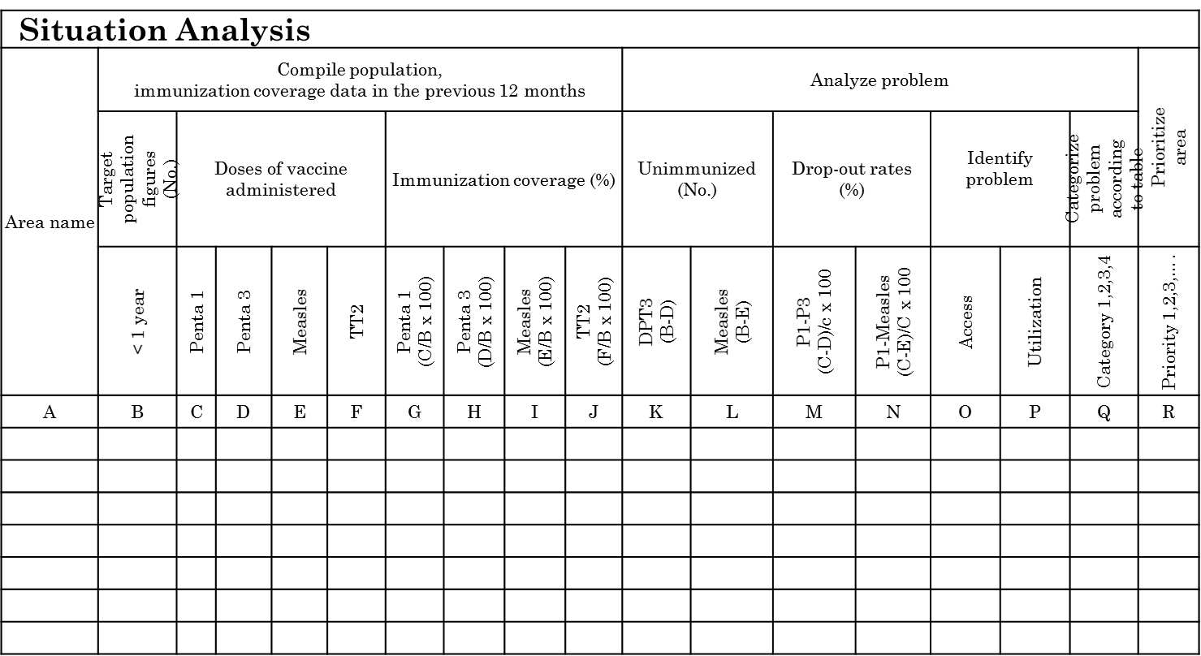
Compile and Analyze Data

Slide 13
Planning special activities for hard to reach and problem areas
List of areas (according to priority) | Category of problem i.e 1,2,3,4 (refer to table 1) | Hard to reach (Y/N) | How many times were they reached last year | Activities that can be conducted by HF level to improve access and utilization | Activities that need support by district or higher level | What other interventions can be delivered at same time as immunization
A | B | C | D | E | F | G

Slide 14
Preparation of a Session Plan
Area name | Total population | Target population | Session type (Fixed, outreach, mobile) | No of injections per year (target population x 11) | No of injections per month | Estimated session/ month (divide by 80 for fixed site and 40 for outreach) | Actual sessions planned per month (realistic judgment) | other child survival interventions planned | Hard to reach area/population (refer to table 3)
I | II | III | IV | V | VI = V/12 | VII | VIII | IX | X

Slide 15
Problem Identification
Using the RED strategy for problem solving
RED components | Problems | Activities with limited resources (HF level) | Activities needing resources and assistance from district | When and area name | Who (person)
Re- establishment of outreach services
Supportive supervision
Community links with service delivery
Monitoring and use of data for action
Planning and management of resources

Slide 16
LEVELS OF MICRO-PLANNING
Province A
Province Plan = Aggregation of District Plans + Province specific activities
District Plans = Aggregation of health center plans + mobile strategy, supervision, monitoring and retro-information
District 1
District 2
District 3
Union Council = Detailed operational plans
Union Council

Slide 17
SESSION PLAN
Cornerstone of effective service delivery
Difficult to implement everything, so decide on the highest priorities
Plan sessions to reach the target population regularly
Build trust with community by ‘sticking to the plan’
Look for the unreached:
  Urban groups (unregistered, lack of awareness, poor)
  Ethnic or religious minorities
  Geographically remote or migrating groups
  ….

Slide 18
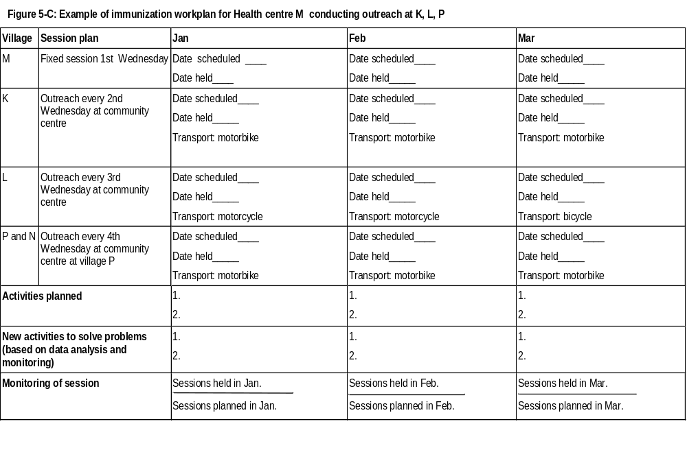
Health Centre Scheduling

Slide 19
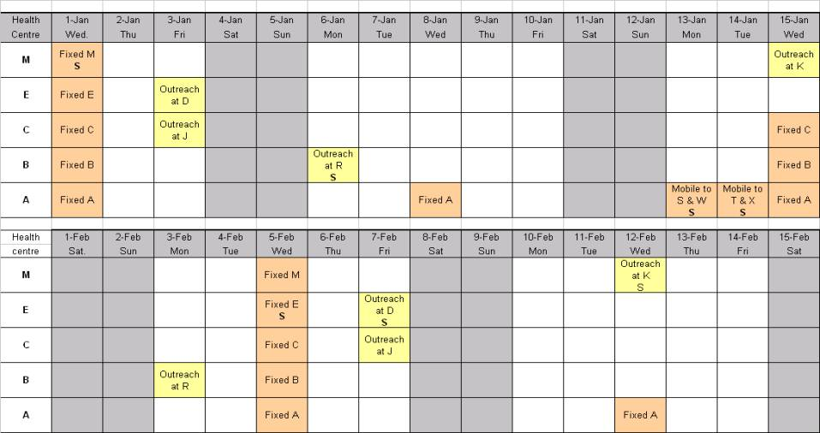
DISTRICT WORKPLAN = SUM OF ALL H.C WORKPLANS

Slide 20
COMMODITIES IN PLACE
Determine monthly and annual needs for vaccines, syringes, safety boxes
Determine equipment needs (cold boxes, refrigerators, needle-removers, etc.)
Aggregate UC micro-plans into district level plans.

Slide 21
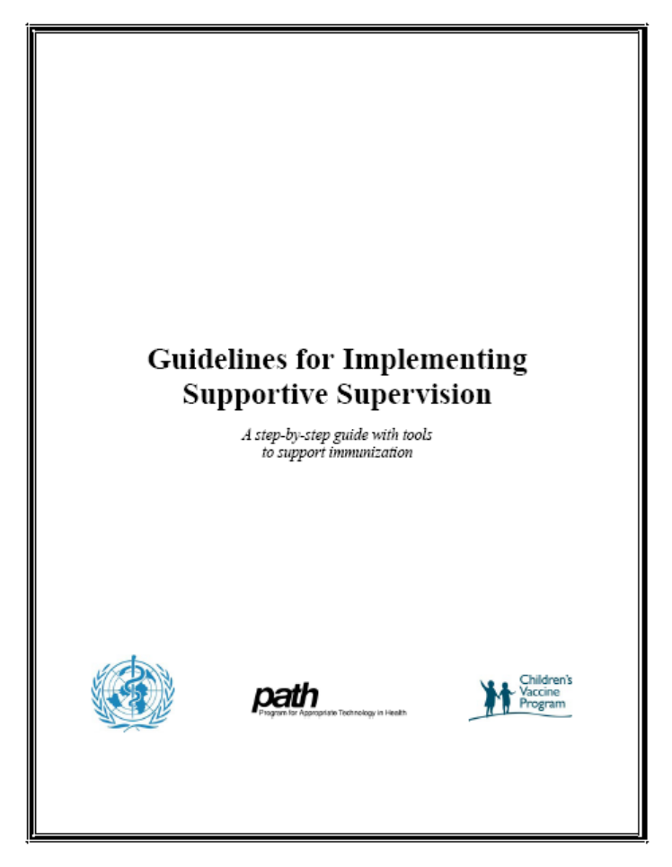
SUPPORTIVE SUPERVISION
Motivate health staff to establish goals, monitor performance, identify and correct problems, and proactively improve quality of performance
Supervision that combines on-site training, problem solving and monitoring
Focus on priority issues for follow-up and record feedback
Supportive Supervision is more than just a check-list

Slide 22
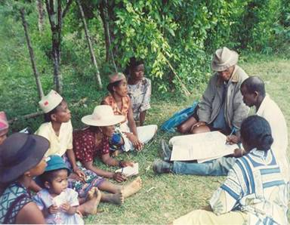
COMMUNITY LINKS
Meet regularly with community leaders and share feedback on performance
Involve local community in planning services that are convenient
Train local village volunteers
Encourage community to support essential activities:
  antenatal & birth registration
  defaulter follow-up
  ‘catch-up’ routine immunization
  Mobilising families

Slide 23
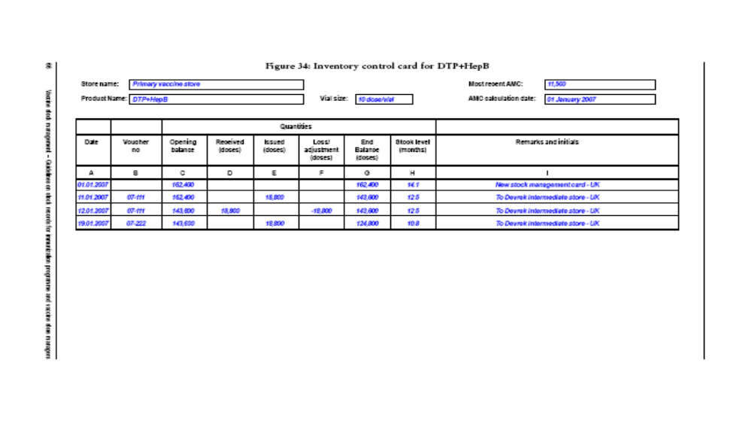
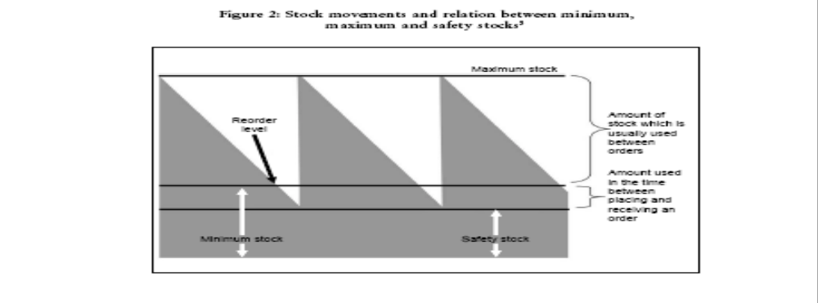
Monitoring Stock

Slide 24
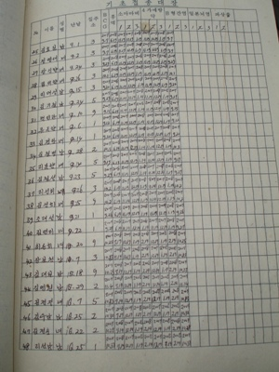
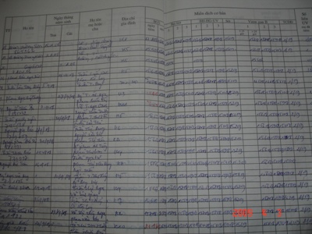
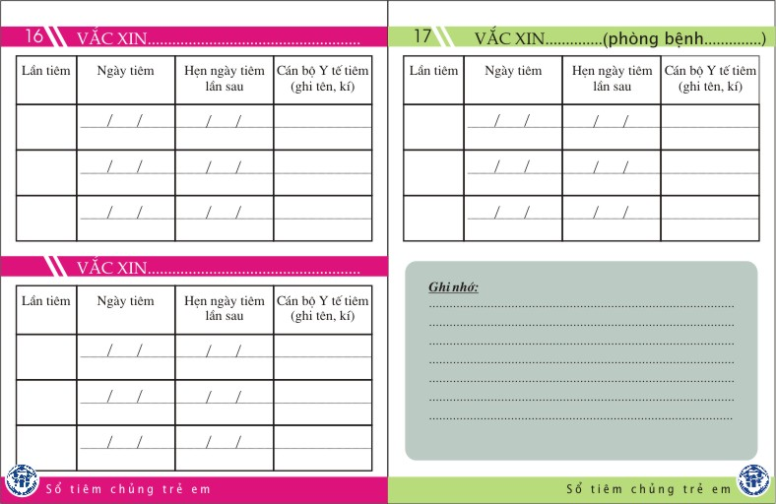
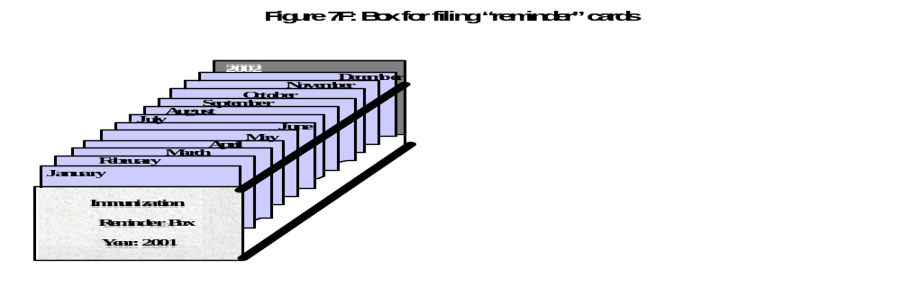
MONITORING TOOLS
“Tickler System” to track follow-up

Slide 25
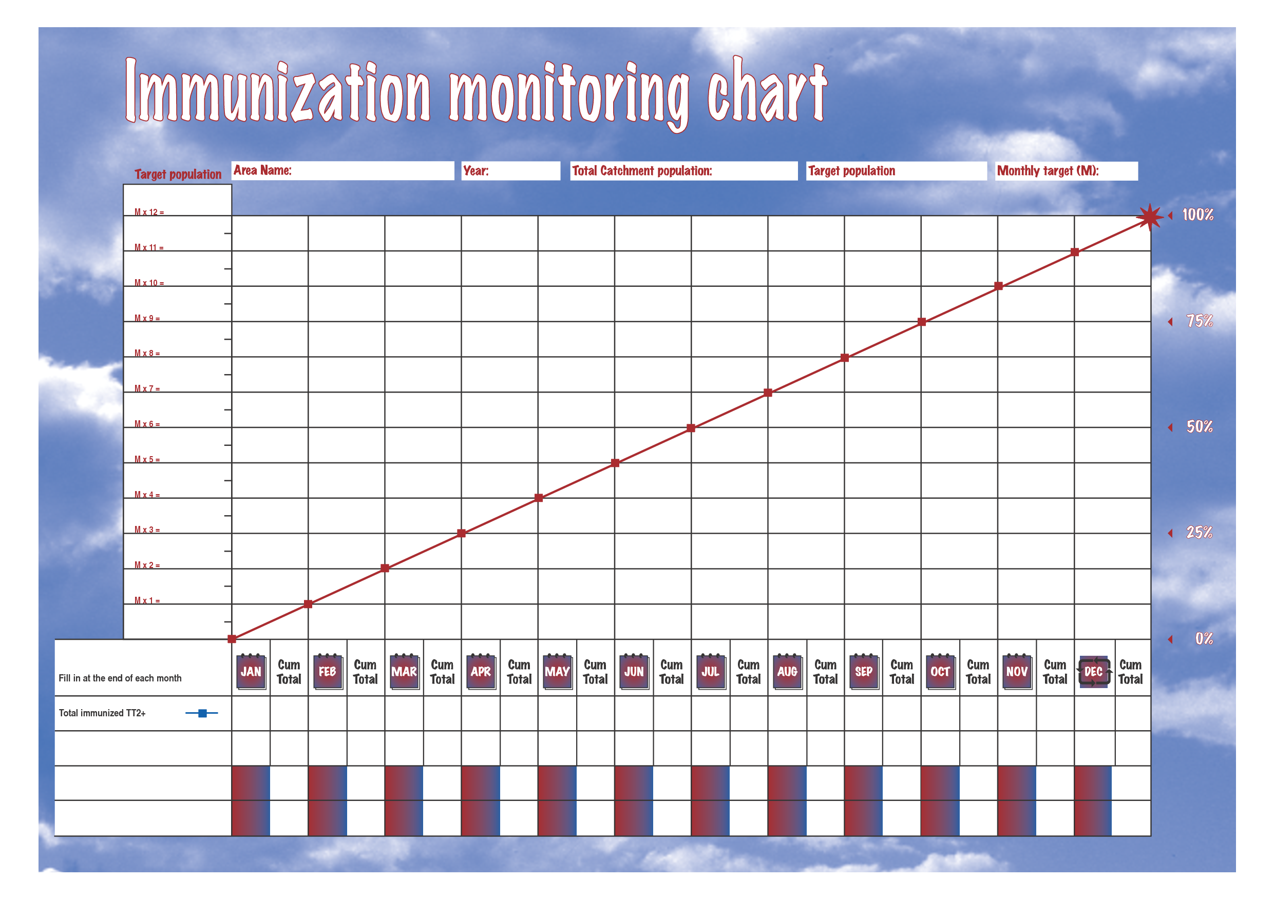
Monitoring Progress

Slide 26
USING DATA TO IMPROVE SERVICES
Compile data
Analyze data to identify problems (monthly, quarterly)
Decide what activities needed to solve problems existing resources or extra resources?
Go back to your work plan and adjust to include these activities
Prioritize the activities on your workplan

Slide 27
PUTTING RED/REC INTO ACTION….
Annual immunisation plans and micro-plans adequately funded
A catchment map in every UC and every health facility
Regular monitoring and review meetings
Routine supportive supervision
Good stock management with no stock-outs
Training and capacity building of staff with low turn-over

Slide 28
